Slide 1



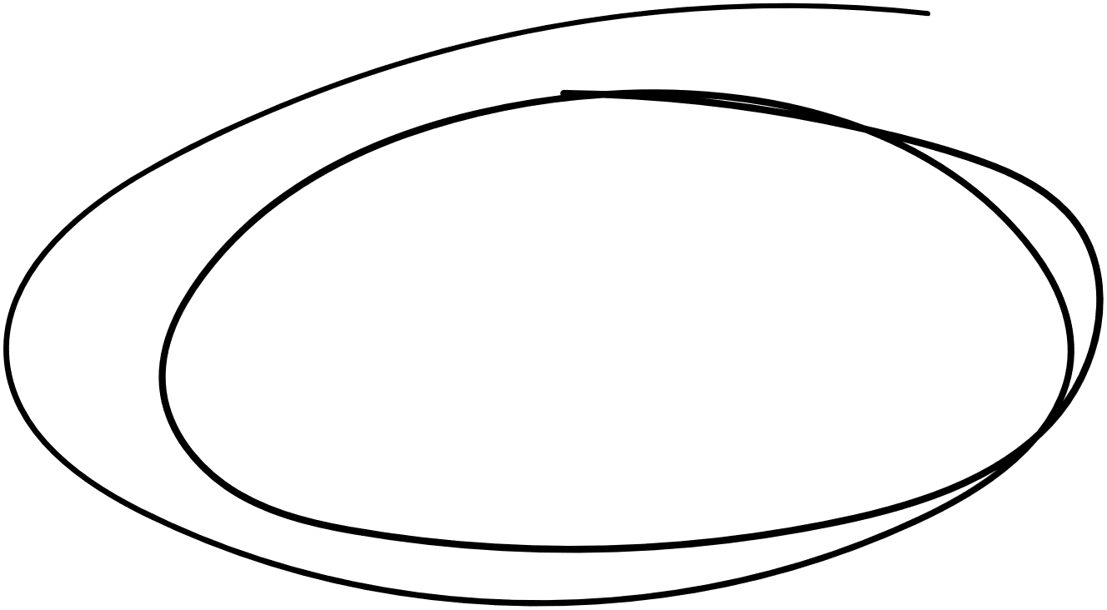












VISUALIZATION OF OPERATIONS ON TREE DATA STRUCTURES
NHÓM 30

Slide 2
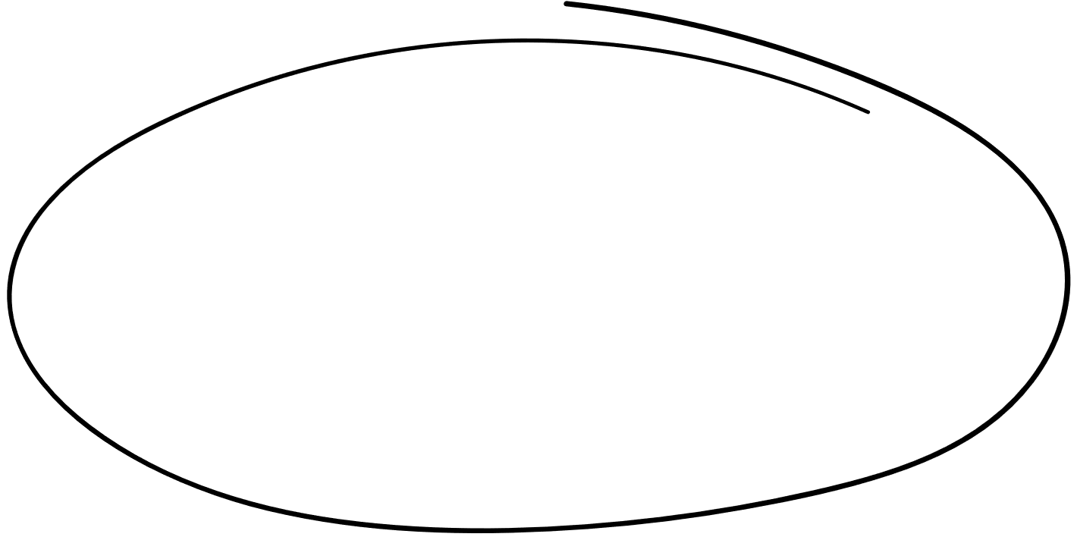





MEMBERS & ASSIGNMENT
NGUYỄN LÊ SƠN -20215131
TEAM LEAD
GENERIC TREE, RED-BLACK-TREE, REPORT, SLIDE
Lê Hữu Tài
Research tree data structures and operations
AVL
Báo cáo
Nguyễn Trung Sơn
BST
Đoàn Bá Sơn
BST

Slide 3

PROBLEM STATEMENT
Picture this: You're a computer science student or just someone who's curious about how tree structures work, but you're struggling to grasp it all. Fear not! A genius project is in the works to create an interactive tool that will help you visualize and understand the ins and outs of different tree structures. You'll be able to play around with various tree types and control the operations with the click of a button. Hit pause, step-by-step, or go full speed ahead! This tool is sure to be a game-changer for anyone interested in computer science!

Slide 4
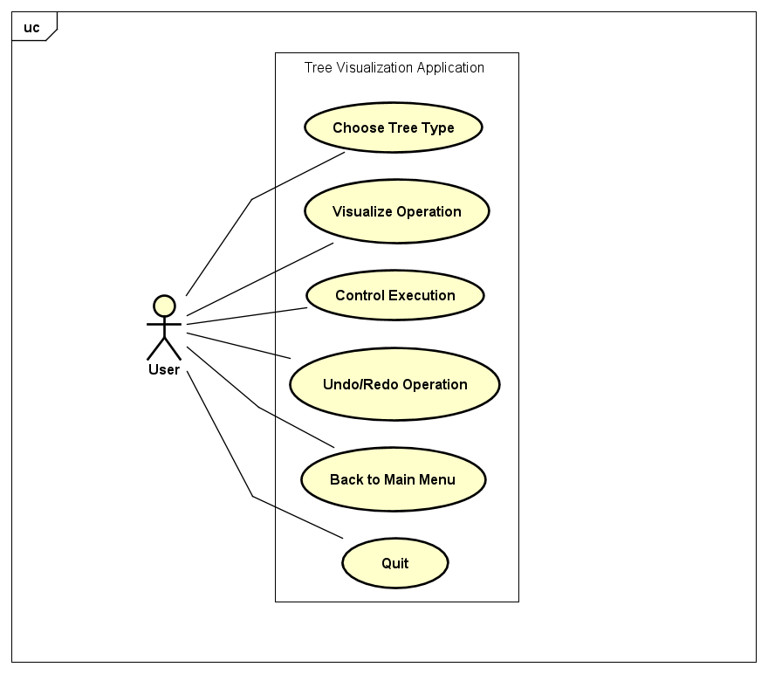
USE CASE DIAGRAM
This is a software that allows users to visualize tree data structures. The user selects a tree type, chooses an operation to visualize, and provides the necessary parameters. The software then visualizes the operation on the selected tree. Users can control the execution, undo/redo operations, and return to the main menu to choose a different tree type or start a new visualization. They can also quit the application.

Slide 5
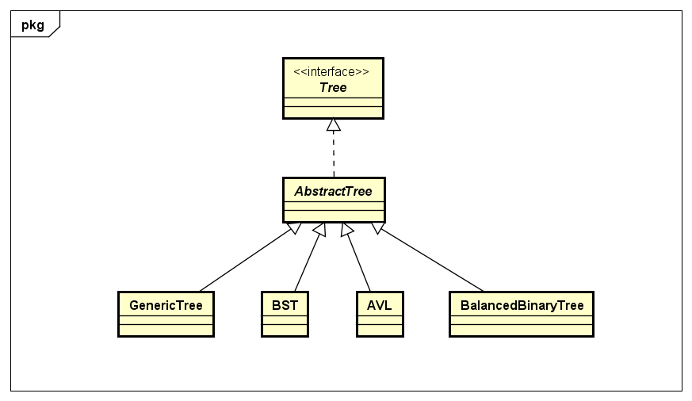
GENERAL CLASS DIAGRAM
The Tree interface declares the methods that all types of trees should implement. The AbstractTree abstract class implements the Tree interface, serves as a base for specific tree types, and encapsulates common behavior among them. The GenericTree, BST, AVL, and BalancedBinaryTree concrete classes extend the AbstractTree class and provide specific implementations of methods for each type of tree. This relationship is an example of inheritance in object-oriented programming.

Slide 6
LINK DEMO

Slide 7
THANK YOU VERY MUCH!

